Slide 1


Slide 2

Design Phase Presentation
Project Title: Automatic Target Recognition by Robotic Arm
Supervisor: Mughees Sarwar Awan
Industrial Supervisor: Dr. Khursheed Hussain
Industry : AI-TECH
Group Members: Saddam Ahmed Nisar (192101024)
Iqra Tanveer (192101015)
Noman Mazhar (192101014)
Dr. A. Q. Khan Institute of Computer Science & Information Technology, KICSIT
Institute of space technology(IST)

Slide 3
Outlines
Introduction
Application
Motivation
Problem Statement
Objectives
Object Detection Algorithm
Robotic Arm
Literature Review
Design and Implementation
Expected Result
Proposed Cost
Project Timeline
Conclusion
References

Slide 4

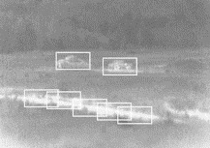
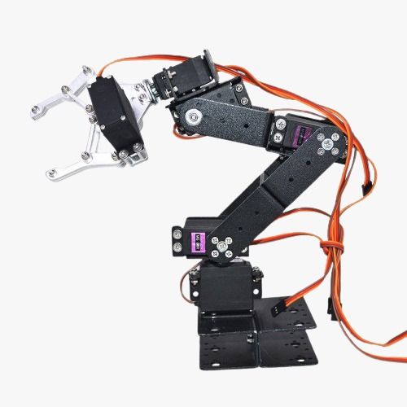
Introduction
An Automatic target recognition is a real time or non-real-time image or signal understanding system. The main aim of our project is to Detect, identify and tacking of dynamic object by using transformer then pick the dynamic object and place it on another location by using robotic arm

Slide 5
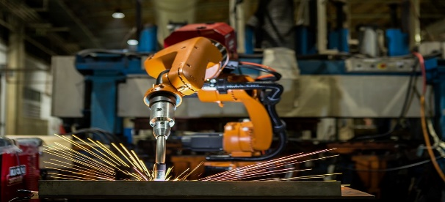
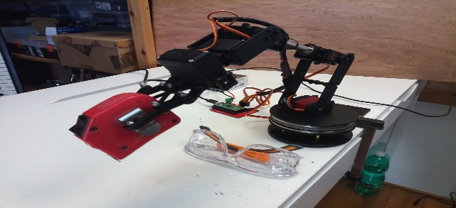
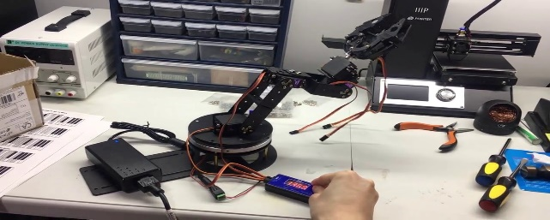
Applications
01
Robotic arm can be used in welding
02
For object pick and place solution
03
For based object sorting

Slide 6
Motivations
To provide Ease to the workers working in factory just doing pick & place for whole day.
To carry Radioactive Materials where human arm is risky to use.
In Corona Virus Pandemic Situation, contactless Applications.

Slide 7

Problem Statement
As the object is moved from the pre fixed potion , the robotic arm is unable to detect and track the object.

Slide 8
Objectives
1
Detection of moving object under robotic arm
Identification of detected object and tracking of object of interest
2
3
Pick and place the targeted object

Slide 9
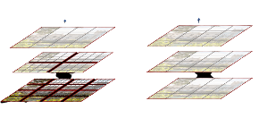
Swin Transformer
The Swin Transformer is a type of Vision Transformer. It builds hierarchical feature maps by merging image patches in deeper layers and has linear computation complexity to input image size due to computation of self-attention only within each local window. The Swin Transformer v2 is a variant of the Transformer architecture, which is a deep learning neural network used in natural language processing tasks such as language translation, text summarization, and sentiment analysis.

Slide 10
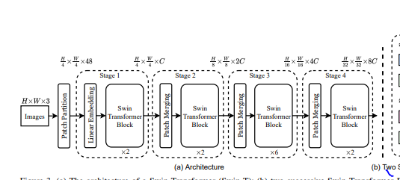
Architecture of Swin Transformer

Slide 11
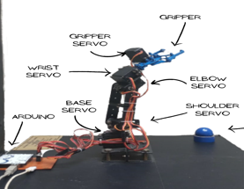
Robotic arm
A Robotic arm functions and operates much like the arm of a human, with joints that can move in different directions.
As the robotic arm picks and places objects it offers something that most other machines cannot. Robotic arm consist of five joints that are Base, Shoulder, Elbow, Wrist and Jaws or Gripper.
It has 5 servo motors Each motor is controlled by Arduino and is moved in accordance with the Arduino code.

Slide 12

Literature Review
The Author Rahul kumar [1] proposed a system in which he used image processing algorithm which is a pre-requisite for the full operation of a pick and place Robotic arm. The major challenge faced in developing the test subjects in compliance with the classifier parameters.
The Author Jesmin F.khan [2] describes an algorithm for the detection of low and high-contrast targets in forward-looking infrared imagery while rejecting the effects of clutter and other associated detrimental factors.

Slide 13

Literature Review
The Author Yiming Zuo[3] Proposed a system that create a large number of synthetic data, trains a vision model in this virtual domain by using 3D model and applies it to real-world images after domain adaptation.

Slide 14
System Design and Implementation
Image is taken from the camera as frames.
Camera is connected to computer system.
Our project proposed algorithm of swin transformer that integrate with Swin which build features map by merging image patches(shown in gray) in deeper layer.
After processing it will be handed to the controller, that move the motors according to the coordinates and robotic arm moves accordingly.

Slide 15
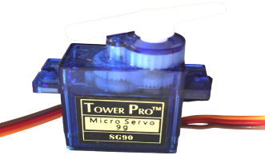
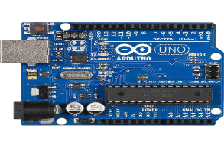
A4 Tech webcam 940ah
GPU Rtx 3090
Robotic Arm
Swin Transformer
System Design and Implementation(Cont..
Hardware:
Servo Motor
Arduino Uno

Slide 16
System Design and Implementation(Cont..
Open CV python
PyCharm
Arduino
Software:

Slide 17
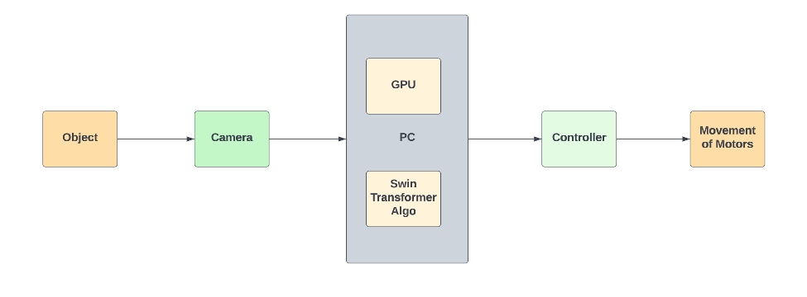
System Design and Implementation(Cont..
Block Diagram:

Slide 18
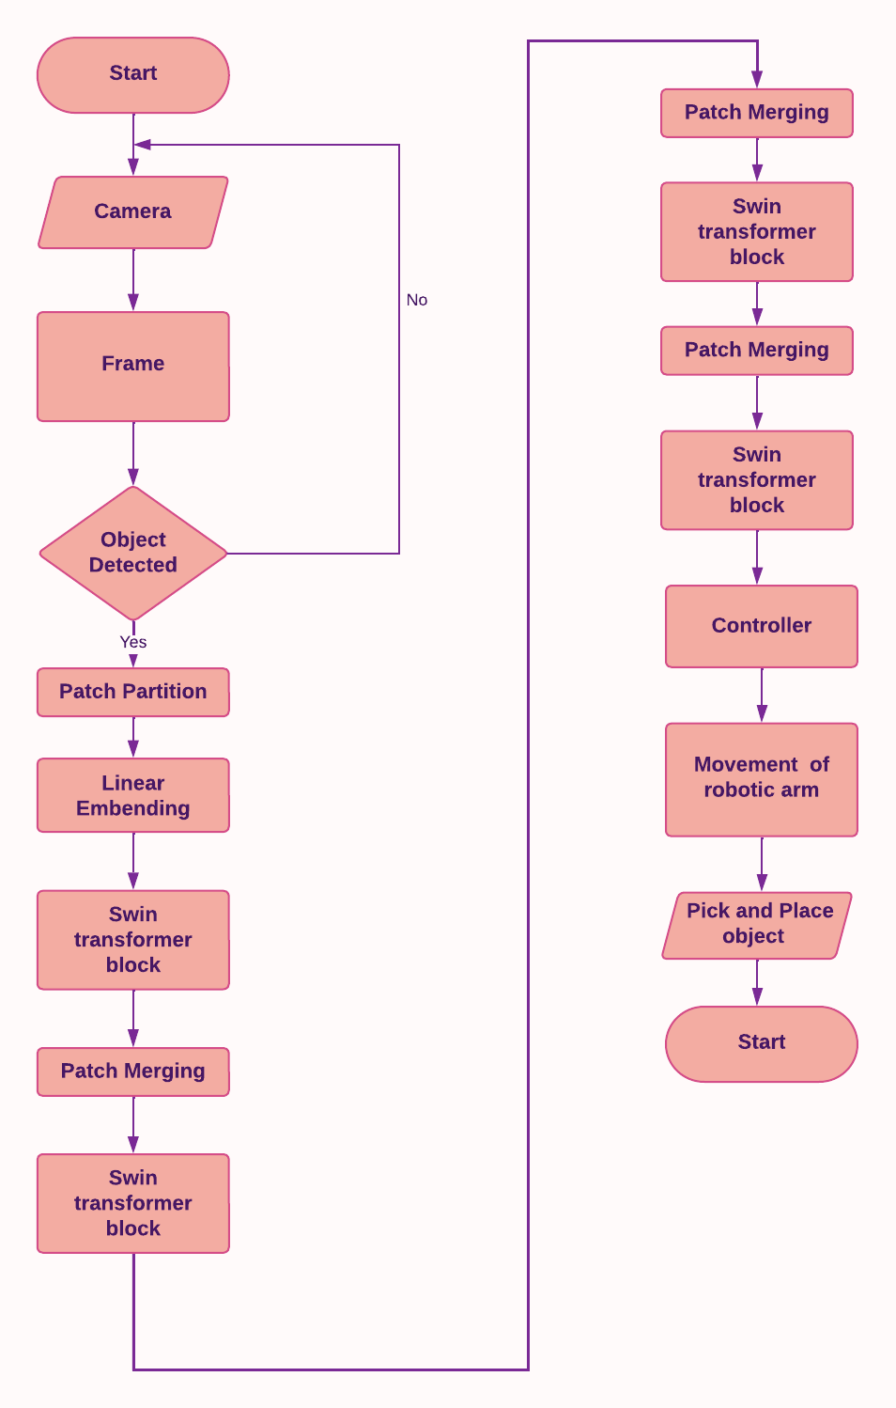
System Design and Implementation(Cont..
Flowchart:

Slide 19
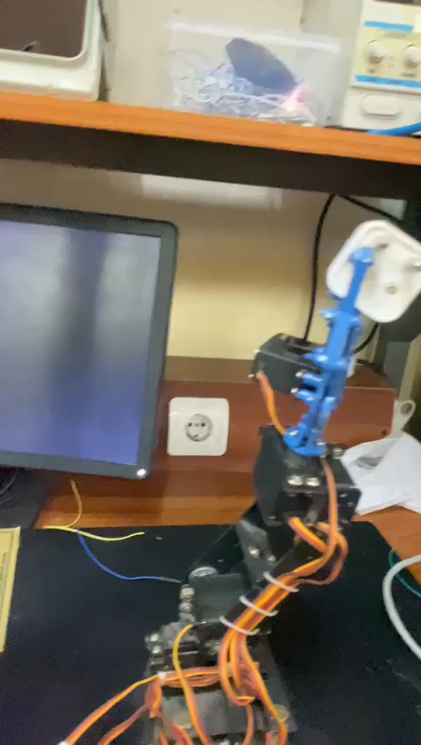
Results

Slide 20
Cost
Components with cost:
Arduino UNO (1) = 2000
Servo motors(5) = 1200*5=6000
Swin transformer(1) =3500
Robotic arm(1) =5000
A4 Tech webcam 940ah(1) =5700
GPU Rtx 3090 (1)=325,000
Total Cost=347,200

Slide 21
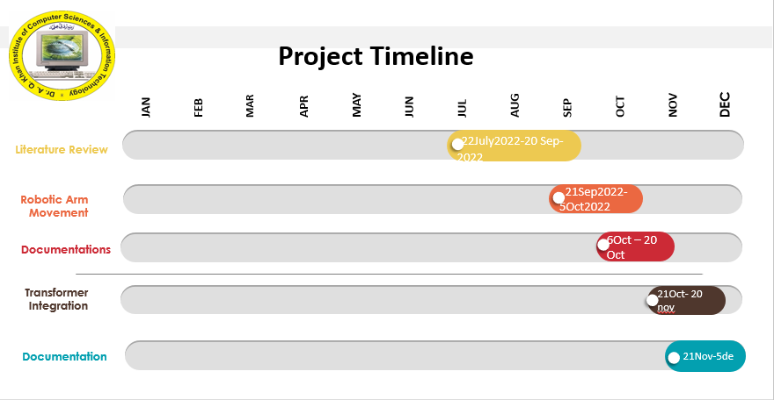

Slide 22
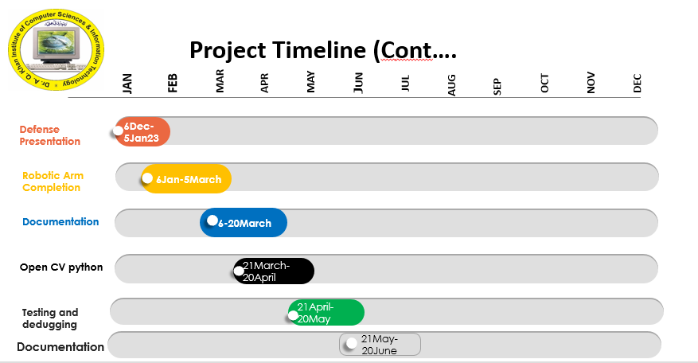

Slide 23
Final Deliverable of the Project
Our final product will be software/hardware integrated system of robotic arm.

Slide 24
Conclusion
After making this project, this project will be able to automatically identify, detect and track the dynamic object and pick and place the targeted object through robotic arm

Slide 25
References
[1] Kumar R, Lal S, Kumar S, Chand P. Object detection and recognition for a pick and place robot. InAsia-Pacific world congress on computer science and engineering 2014 Nov 4 (pp. 1-7). IEEE.
[2] Khan JF, Alam MS. Target detection in cluttered forward-looking infrared imagery. Optical Engineering. 2005 Jul;44(7):076404.
[3] Zuo, Yiming, et al. "Craves: Controlling robotic arm with a vision-based economic system." Proceedings of the IEEE/CVF Conference on Computer Vision and Pattern Recognition. 2019.

Slide 26


Slide 27


